Slide 1
INTENSHIP PROJECT REPORT
Done BY:
Rakshitha.M
Sumedha.VK

Slide 2
WHAT IS WEB DEVELOPMENT
Web Development is the planning and creation of Websites.
It deals with the process of developing a website.
Web Development ranges from creating plain text pages to complex web-based applications, social network applications and electronic business applications.
There are two broad division of Web Development:-
Front-end Development(also called Client-side Development )
Back-end Development(also called Server-side Development)

Slide 3
Summary:-
The process of designing, constructing, and supporting websites and web applications on the internet is referred to as web development. It includes the integration of databases and other server-side elements, as well as the connection of front-end and back-end technology.
Front-end development combines HTML, CSS, and JavaScript to design and construct a web page's visual elements with an emphasis on the user interface and user experience. To increase user involvement, this includes developing layouts, styling, and including interactive elements.

Slide 4
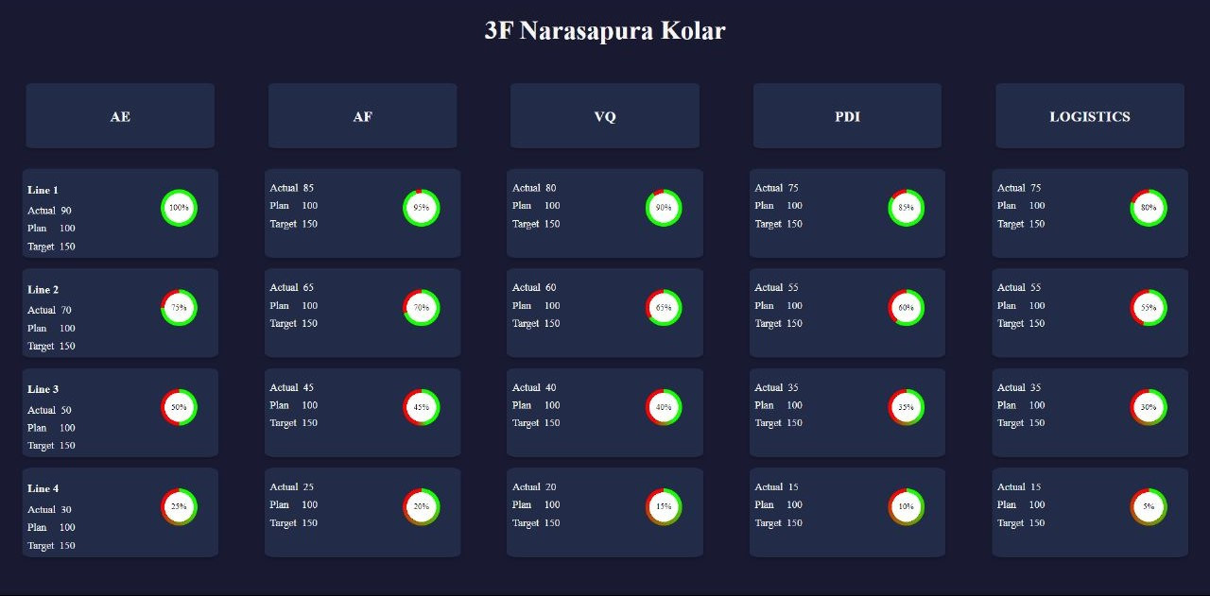
TASK -01
Auto Mobile Production Plant Dashboard:

Slide 5
The dashboard displays progress bars for different production lines and provides relevant information.
Dashboard was created using HTML and CSS
It provides an overview of the production status, efficiency, and progress, helping plant managers and supervisors make data-driven decisions to optimize production.
Basically it keeps updating the data every few seconds or few minute’s.
The speedometer is used as a progress indicator for different production lines
For example:
Line 1: Actual Progress: 90%, Planned Progress: 100%, Target Progress: 150%
The cards are used to display key information related to different aspects of production and departments within the plant.

Slide 6
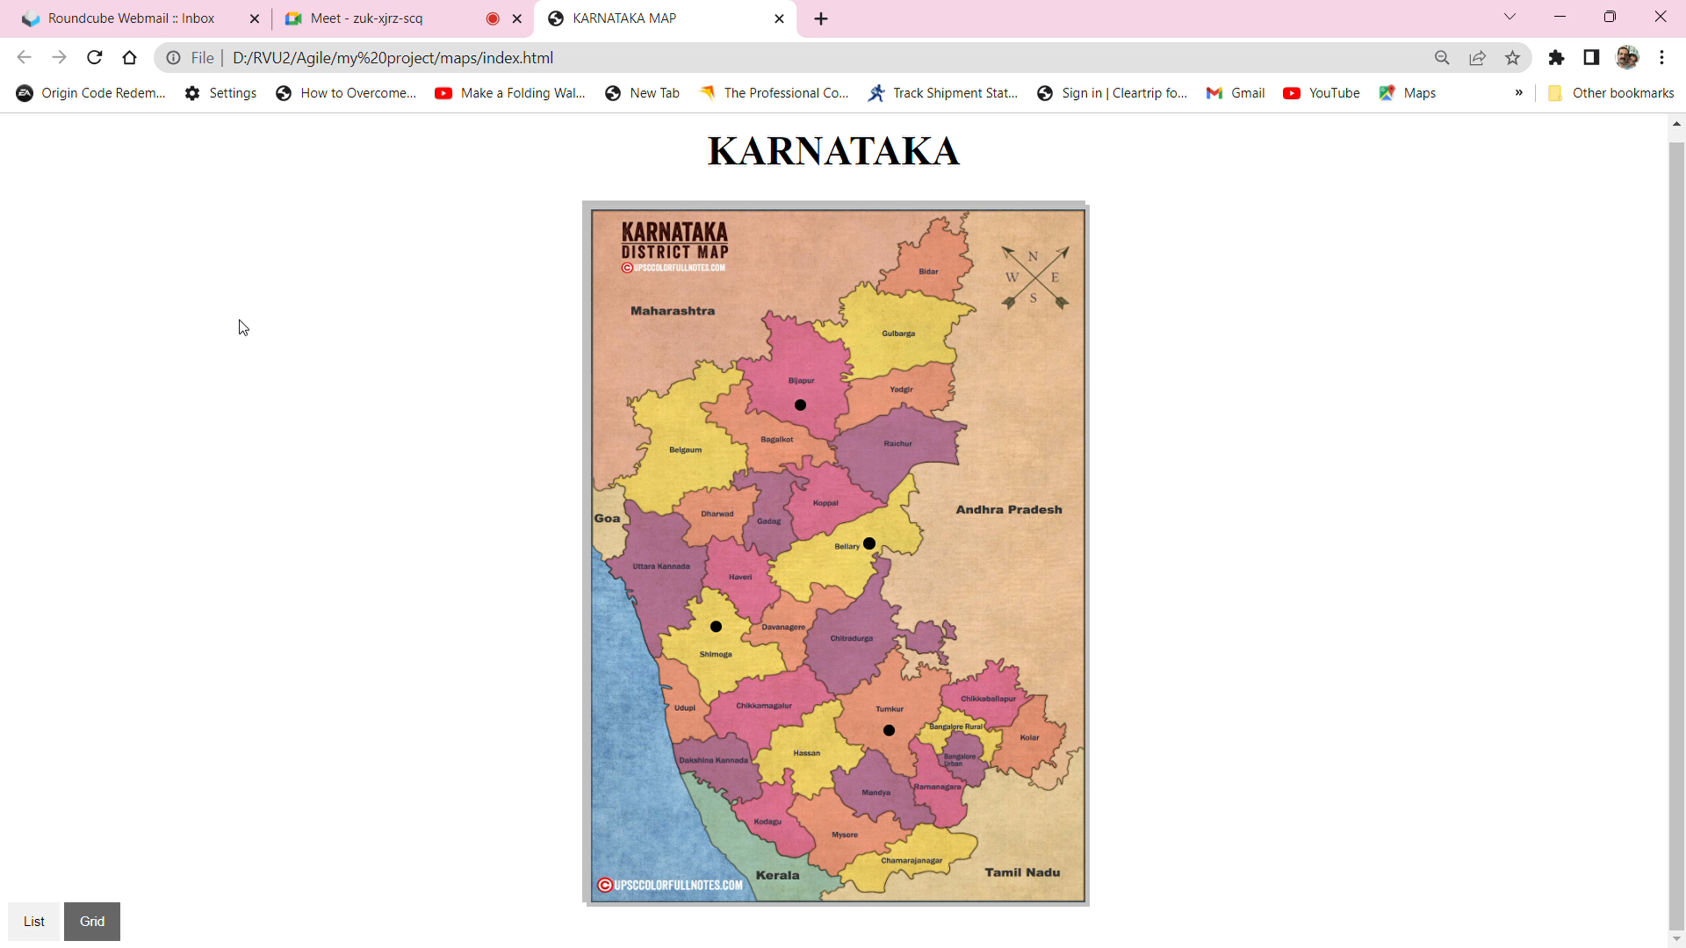
TASK-02
Interactive Map:

Slide 7
A user-friendly and unique way of expressing geographic information and facts is through an interactive map with pop-ups.
Users can interact with the map by clicking on particular locations or regions to access further information displayed in windows that pop up.

Slide 8
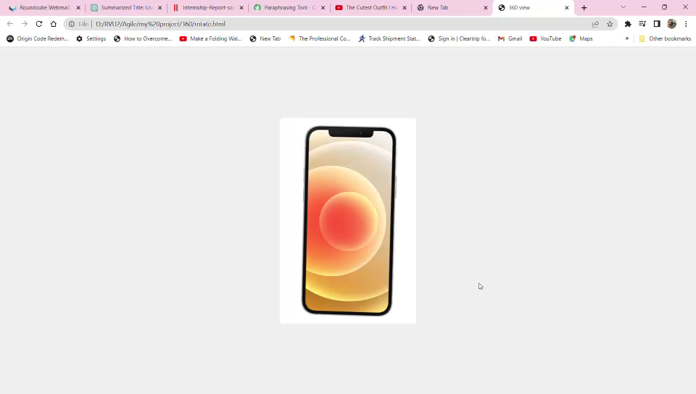
TASK-03
360-Degree View of Products:

Slide 9
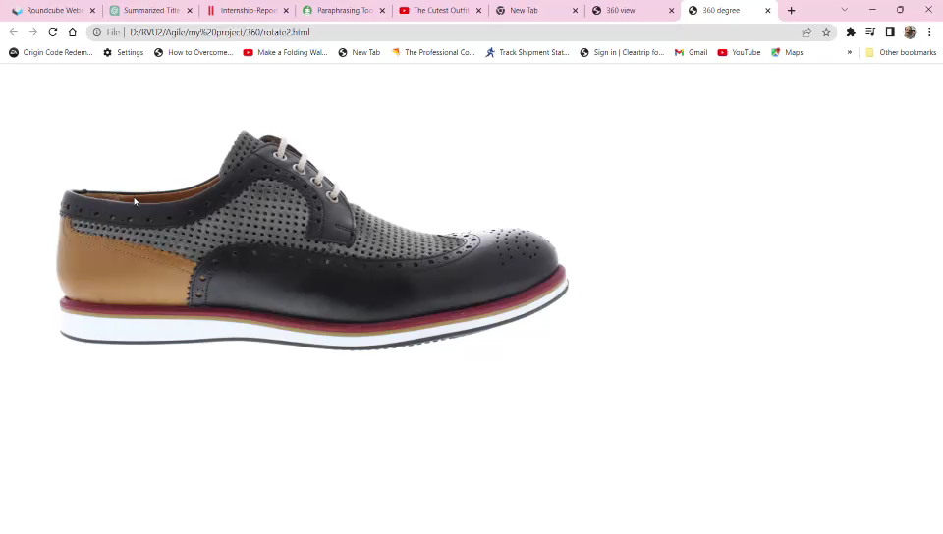
An engaging and comprehensive experience is offered by a 360-degree view of shoes, which is a dynamic visual display that enables consumers to observe a product (as in this case, shoes) from all sides.

Slide 10
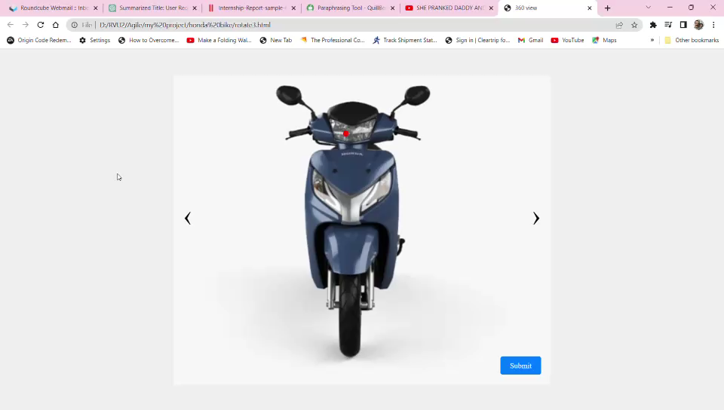
TASK-04
360-Degree View of Auto Mobile Product with Labelling

Slide 11
A comprehensive and immersive experience that enables customers to view a Honda scooter from all sides with an interactive representation portrayal.
Displaying 360-degree views of all of the parts that are available for each model might be an option for selecting any damage or faculties.

Slide 12
CONCLUSION
In web development, a front-end developer plays an important part, concentrating on designing the user-facing components of a website or application.
They are excellent in using HTML to categorize content, CSS to style and arrange it, and JavaScript to make webpages more interactive.
Front-end developers must keep up with the most recent developments, technologies, and techniques because the area is constantly developing.

Slide 13
THANK YOU!

